Slide 1
Voice-Controlled Thumper Vehicle
Milestone II - Components & Initial Design
Ahmed Leithy 900160088
Yahia Farid 900161331
Yousef Koura 900160083

Slide 2
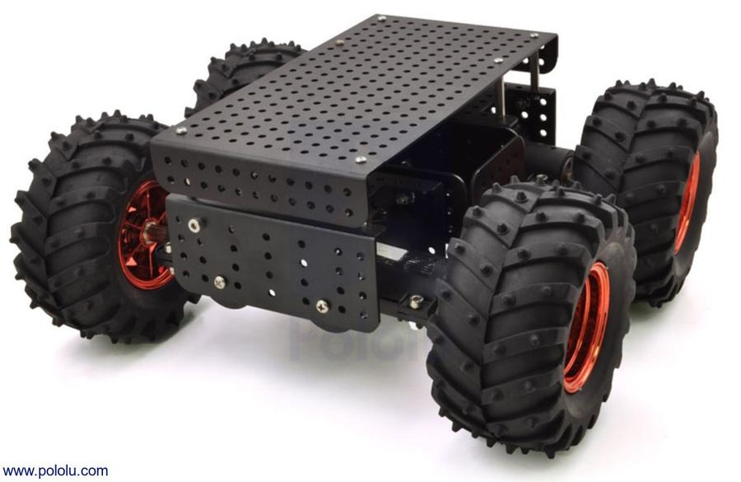

Our Idea
Dagu Thumper vehicle controlled with voice commands
Commands are processed by a machine learning model
Model uses the Tensorflow-Lite for microcontrollers platform

Slide 3
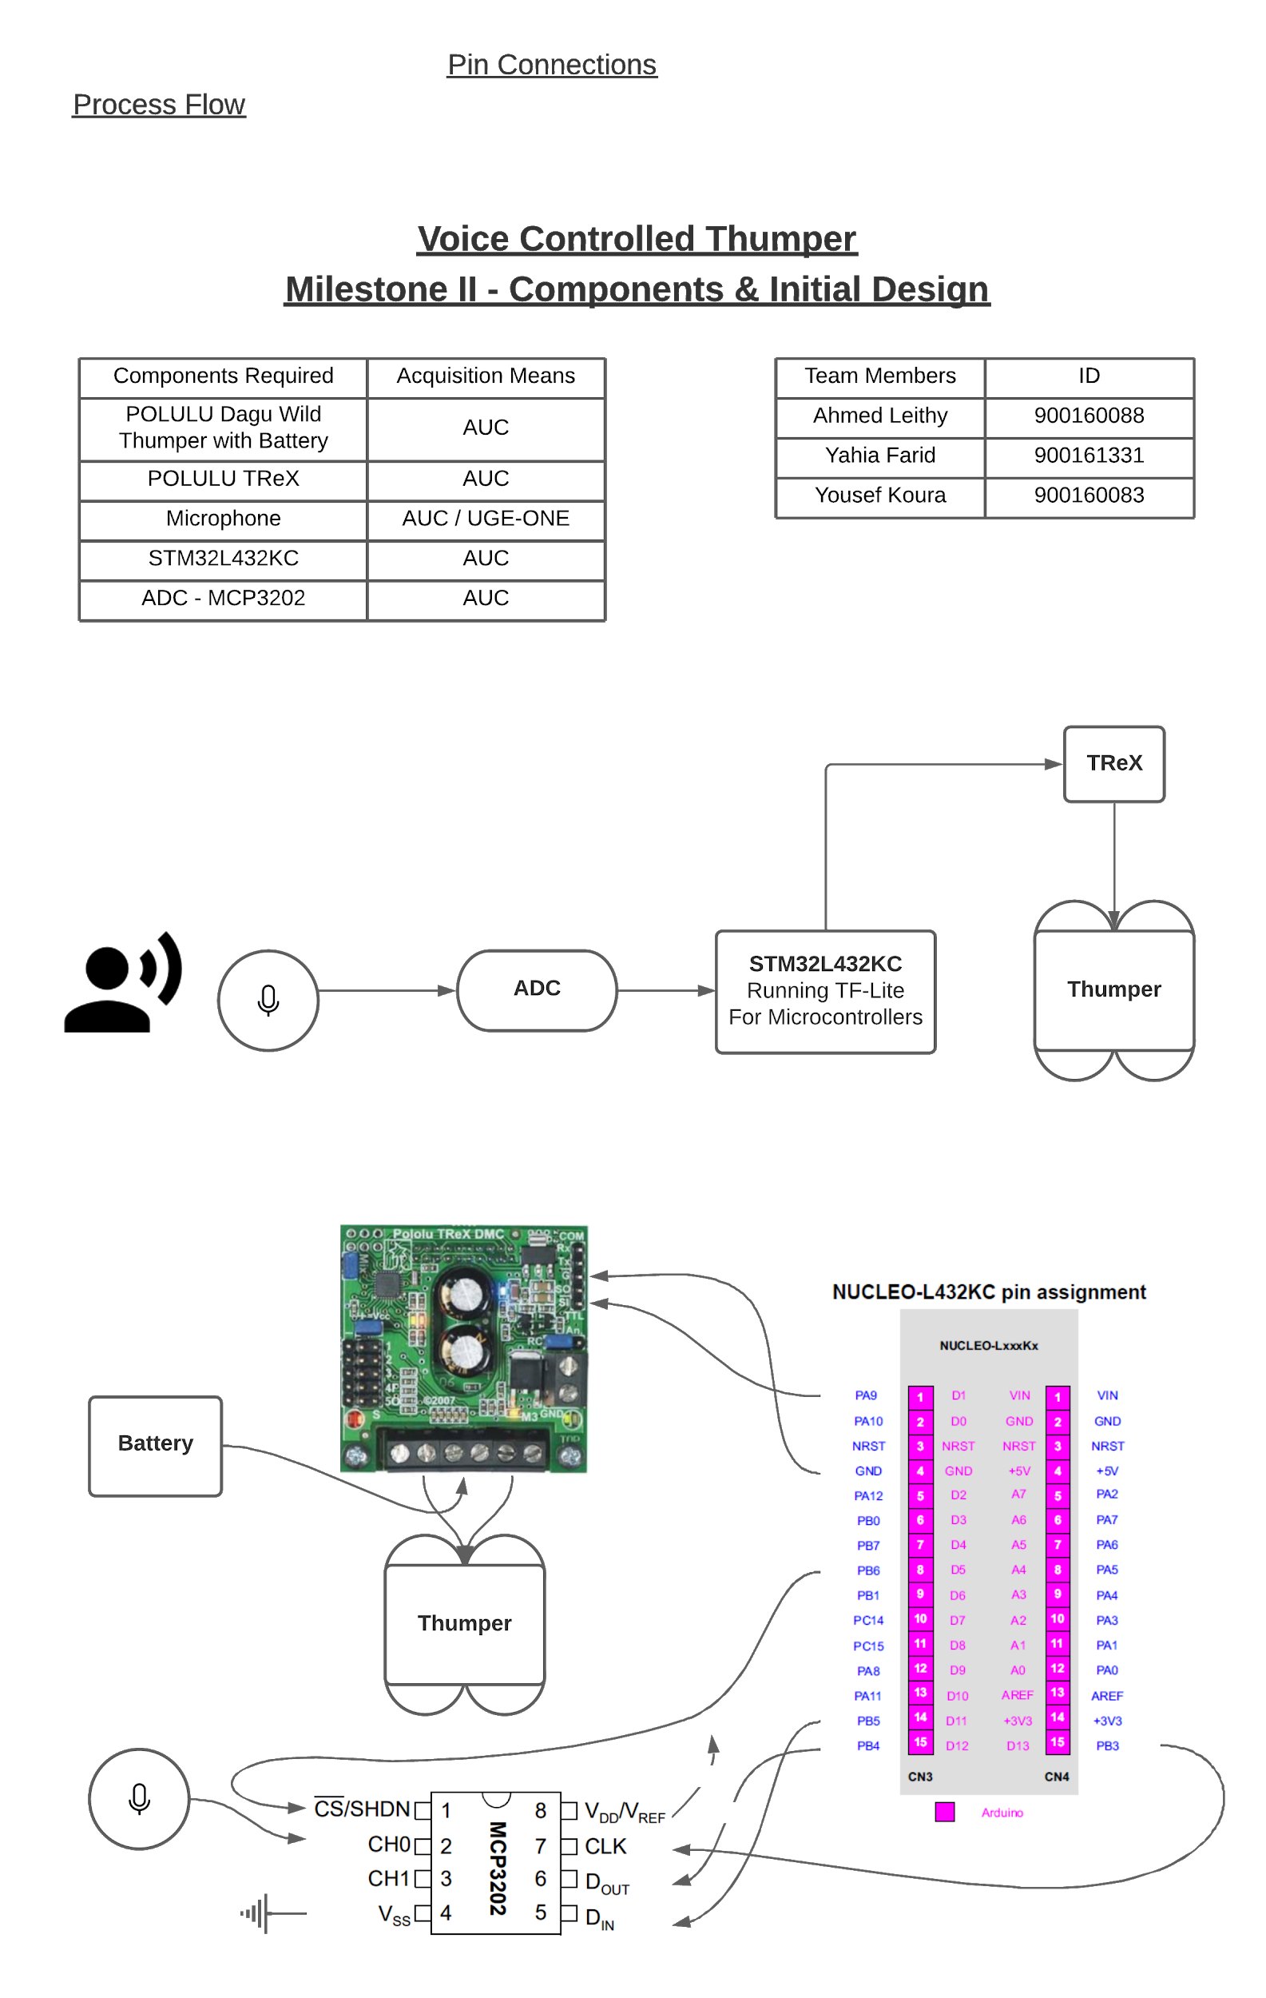
Process Flow

Slide 4
Pins and Connections

Slide 5
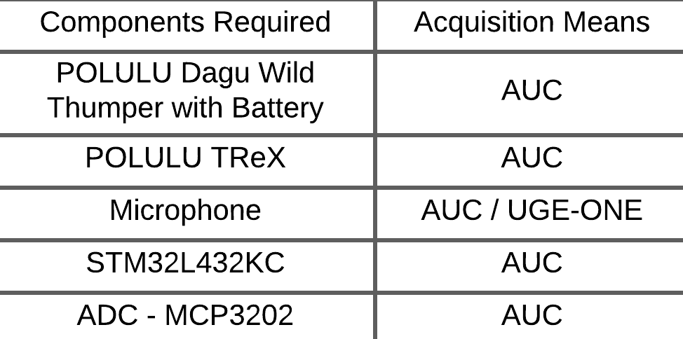
Components Required (HW)

Slide 6
Tools (SW)
TensorFlow-Lite for microcontrollers
Using a pretrained model
Keil μvision IDE
STM32CubeMX

Slide 7
Thank You!

